Slide 1


Slide 2
Windows 12
install

Slide 3
Coping files 100% getting files ready for installon 100% installing fearcres 100% rebooting….
done

Slide 4
Coping redgistry settings 100%

Slide 5
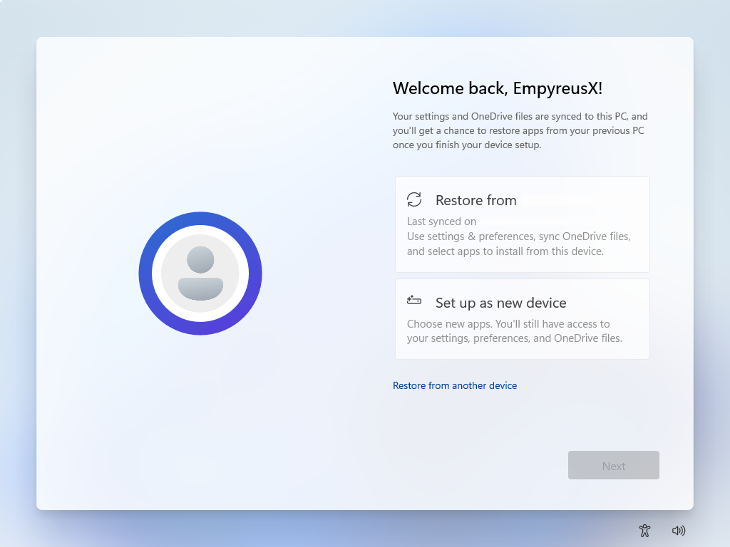
Windows10prouluratech
This Photo by Unknown Author is licensed under CC BY-SA

Slide 6
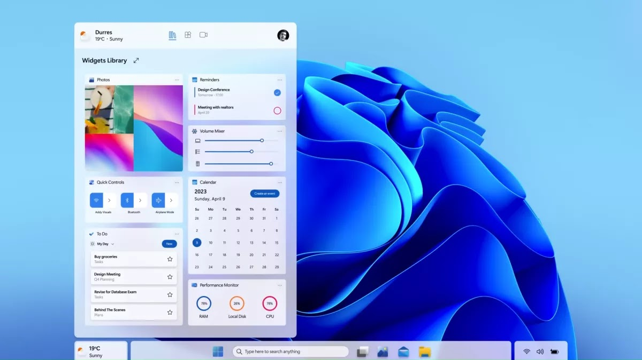
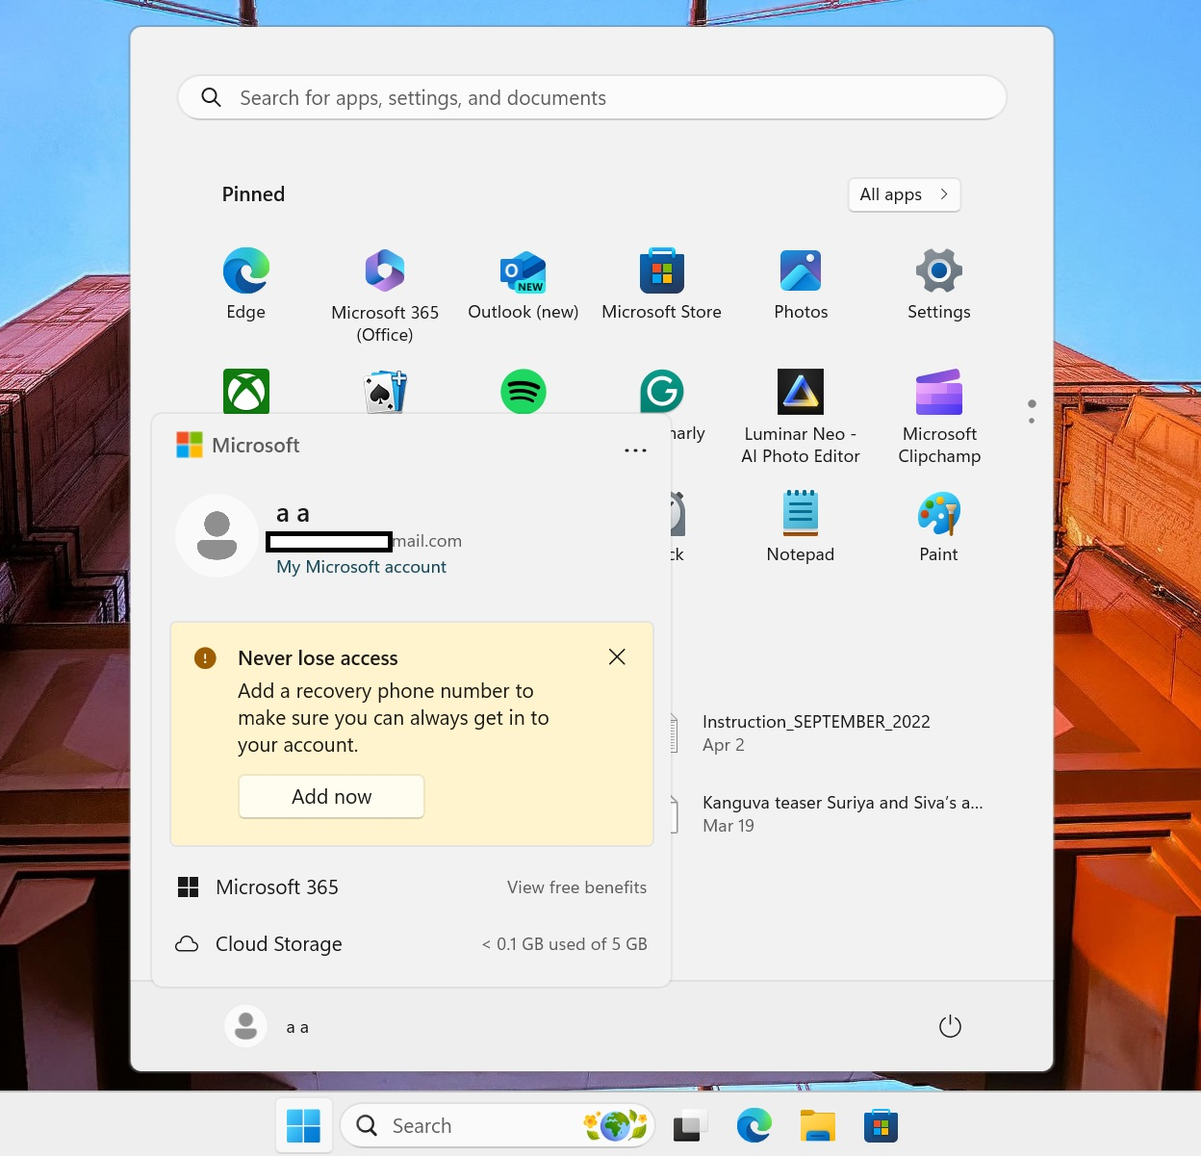
Windows10proulratech
This Photo by Unknown Author is licensed under CC BY-SA

Slide 7
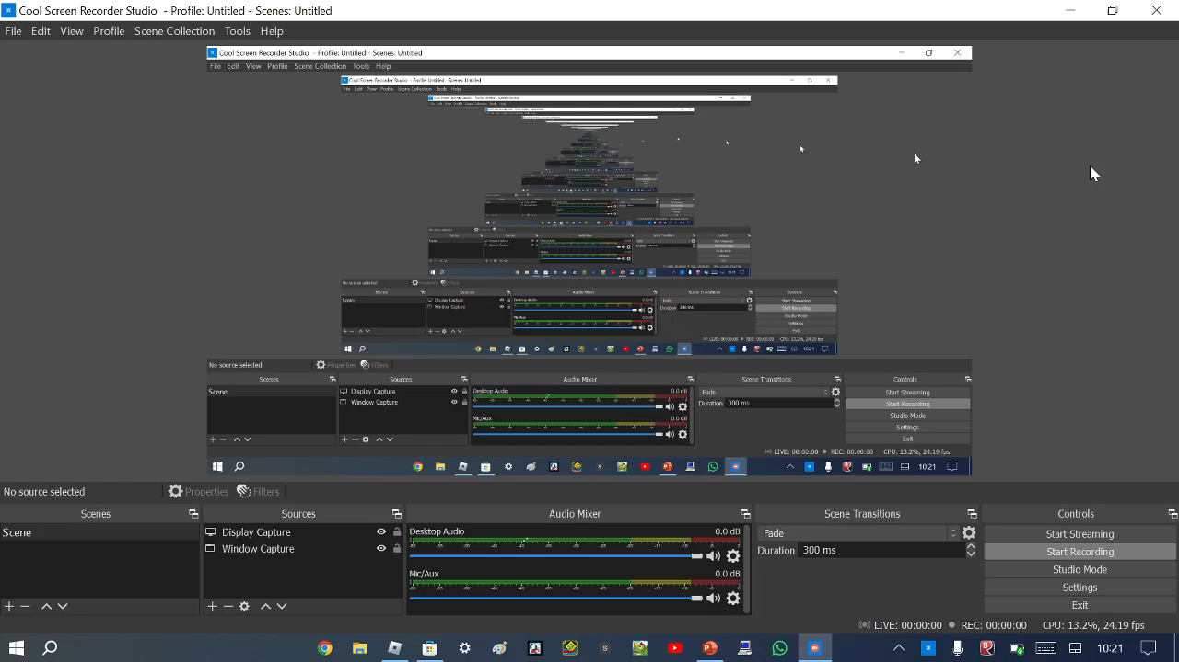

Slide 8
